Slide 1
CS 347 Project
Erica Halpern, Lindsey Kehlmann, & Michelle Lawrence

Slide 2
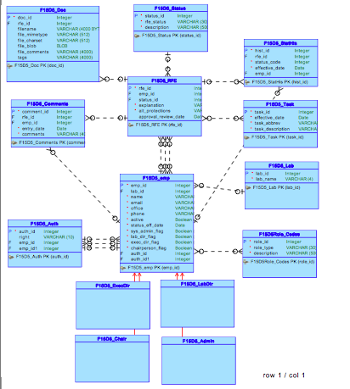

Slide 3
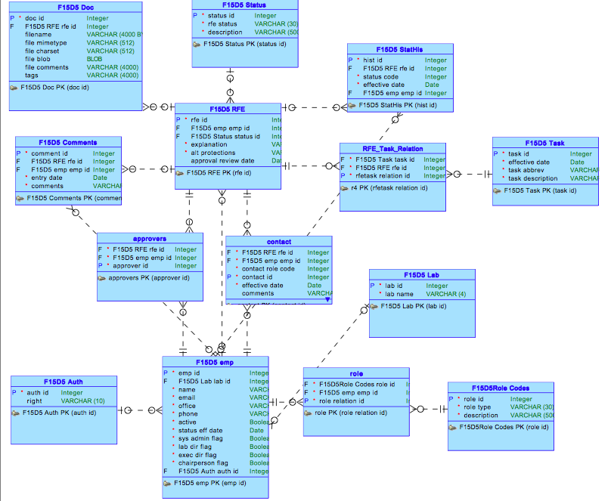

Slide 4
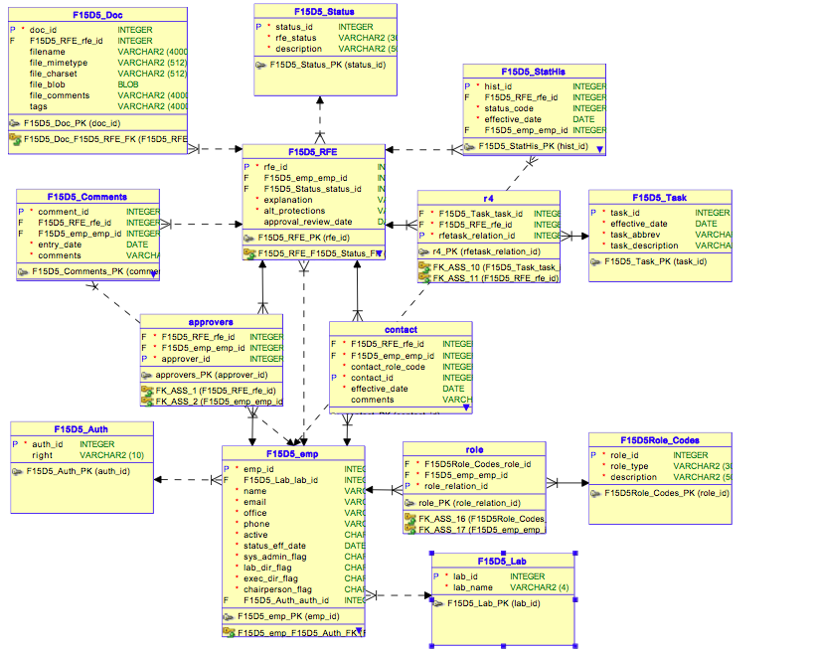

Slide 5
Application screenshots

Slide 6
User Experience Design Decisions
Login
Employees
RFEs
Sign in Page
Employee Page
Employee Title Pages (exec dir...etc.)
All My RFEs Page
Pending
Requested
Logged in Employee Table
RFEs I Requested
RFEs needing my approval
RFEs I Requested
Employee Roster
RFEs needing my approval
RFEs where I’m a Contact

Slide 7
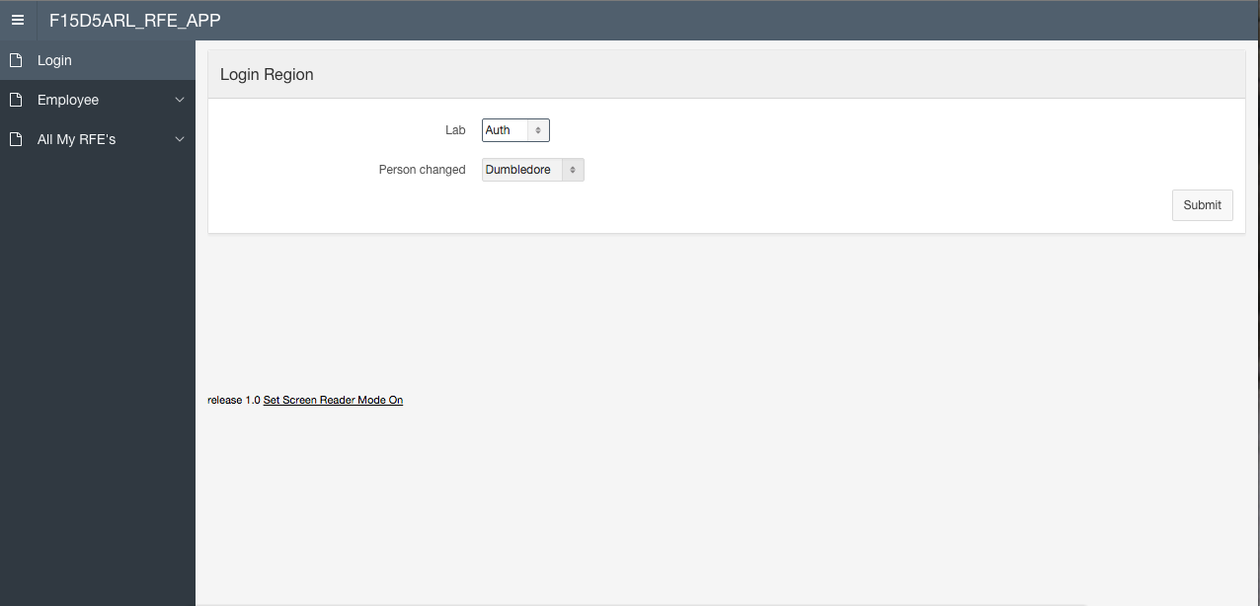

Slide 8
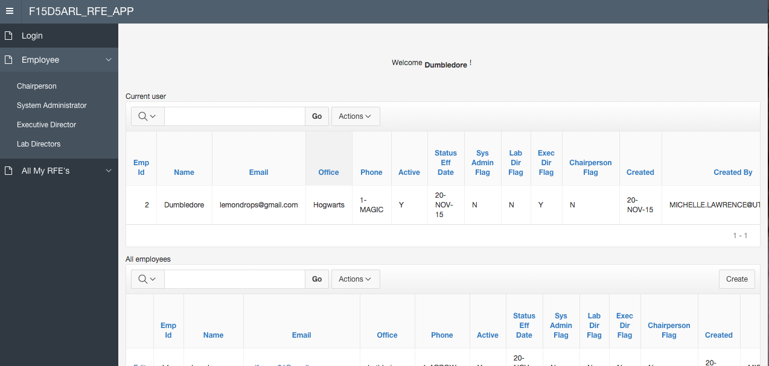

Slide 9
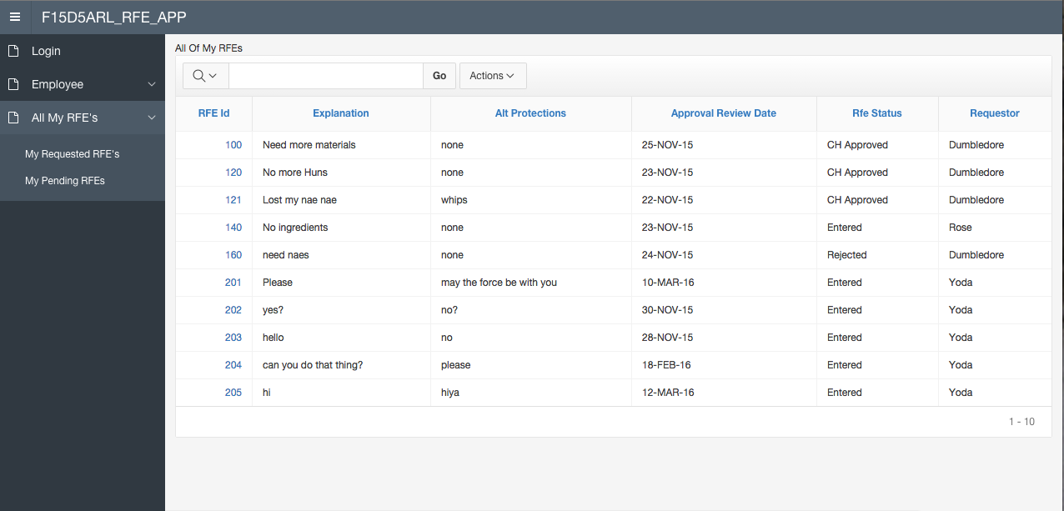

Slide 10
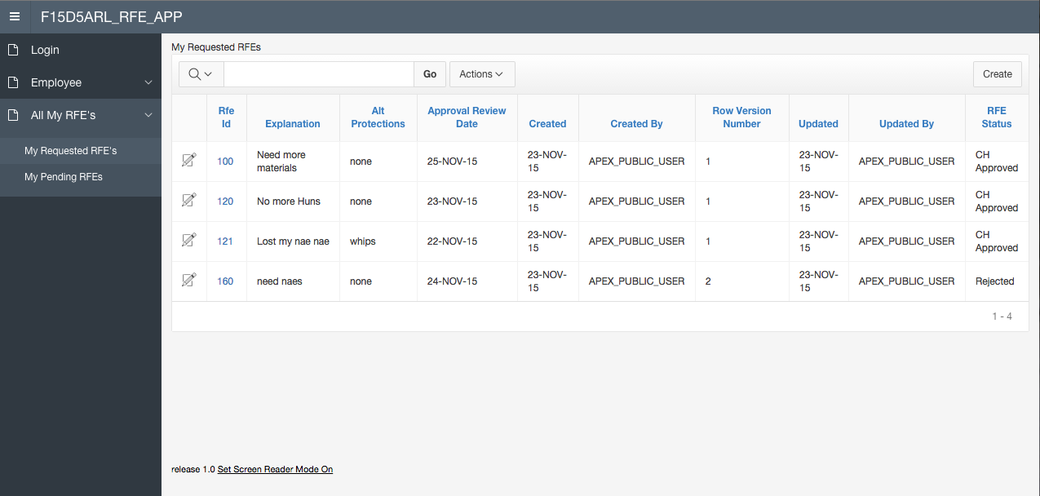

Slide 11
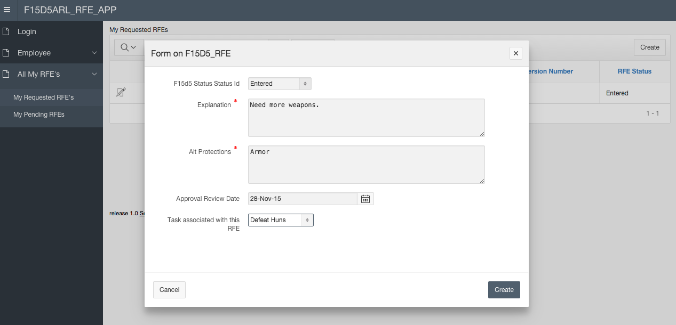

Slide 12
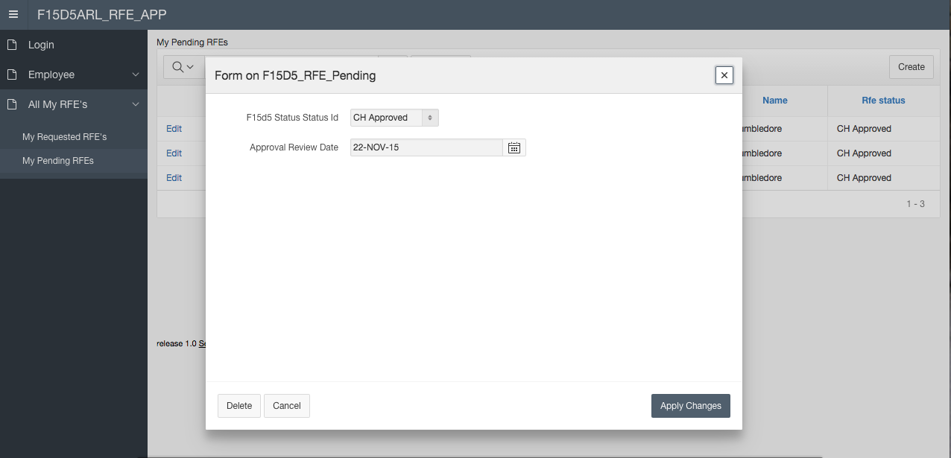

Slide 13
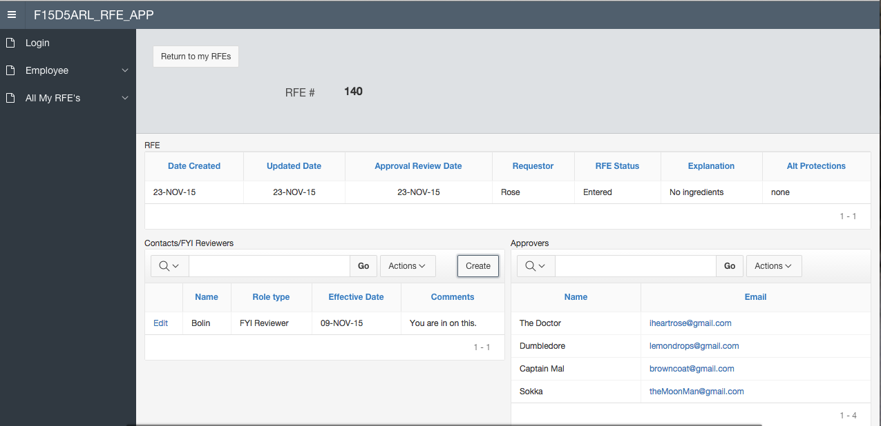

Slide 14
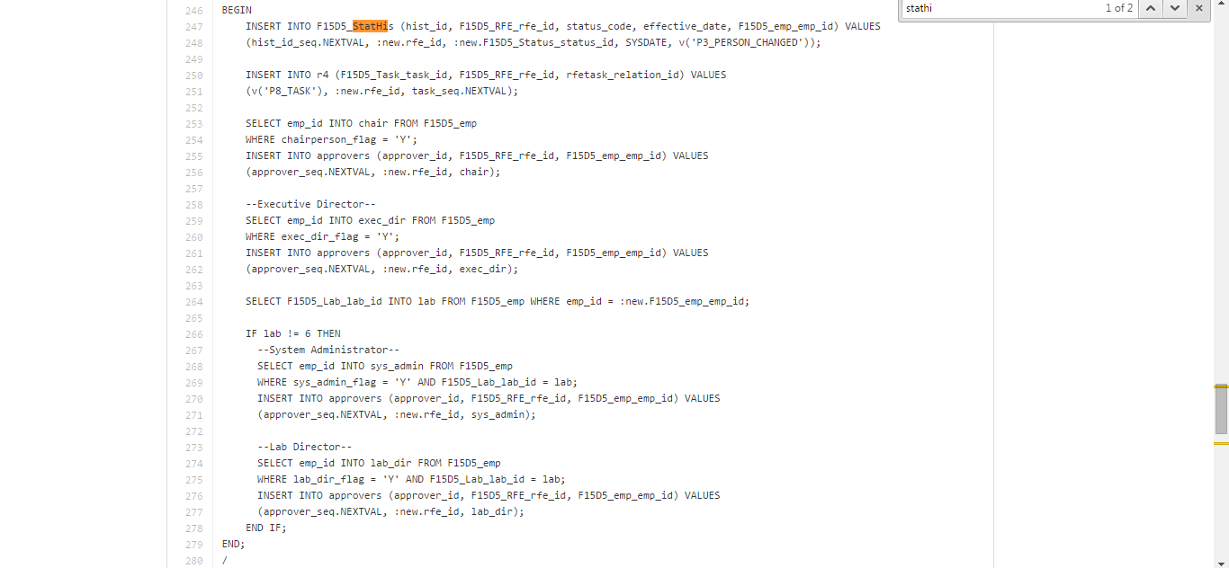
Insert or Update RFE Trigger

Slide 15
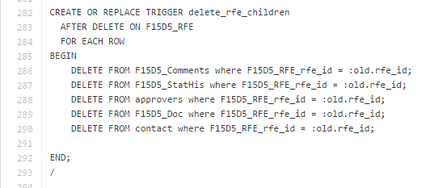
Delete RFE Trigger

Slide 16

Part II Description and screenshots
Part II of our project is meant to act like a beverage menu depending on season. Seasonal drinks are displayed with prices, descriptions, ingredients, etc.

Slide 17
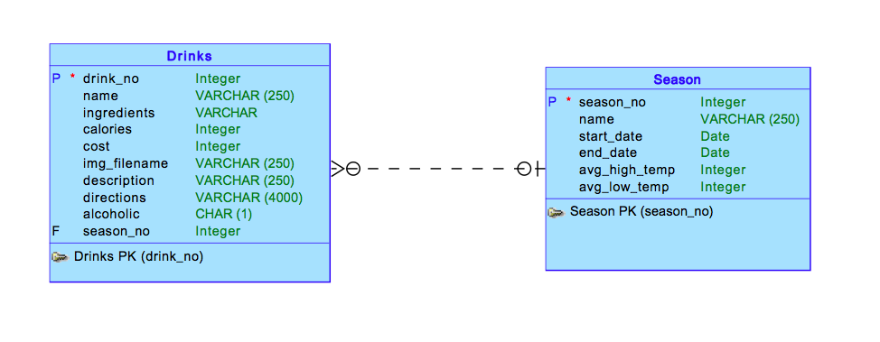
Part II Conceptual Model

Slide 18
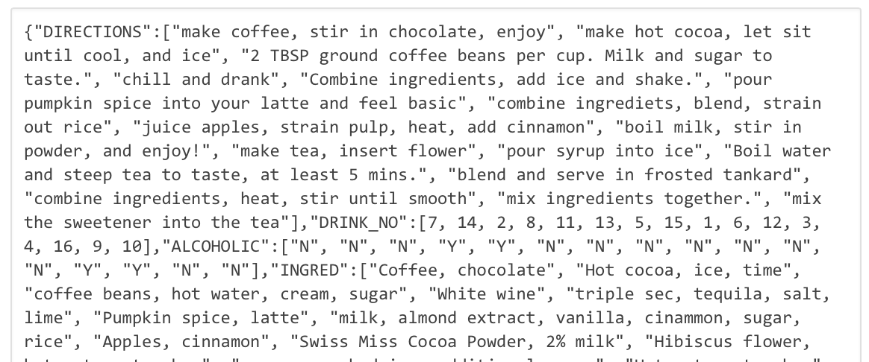
Process — Fall Drinks
Cypher Query
"MATCH(a:drink)<-[:drinks]-(b:season) WHERE b.seas_no = 4 RETURN b.seas_no, b.name, a.dname, a.cost, a.descr"
SQL Query select jt1.dname dname, jt2.cost cost, jt3.descr descr, jt4.X0_1 X0_1, jt5.X1_1 X1_1 from apex_collections t, json_table(t.clob001, '$.DNAME[*]' COLUMNS rid for ordinality, dname varchar2(100) path '$') jt1, json_table(t.clob001, '$.COST[*]' COLUMNS rid for ordinality, cost varchar2(100) path '$') jt2, json_table(t.clob001, '$.DESCR[*]' COLUMNS rid for ordinality, descr varchar2(100) path '$') jt3, json_table(t.clob001, '$.X0_1[*]' COLUMNS rid for ordinality, X0_1 varchar2(100) path '$') jt4, json_table(t.clob001, '$.X1_1[*]' COLUMNS rid for ordinality, X1_1 varchar2(100) path '$') jt5 where t.collection_name = 'P20_DOREST_RESULTS' and jt1.rid = jt2.rid and jt2.rid = jt3.rid and jt3.rid = jt4.rid and jt4.rid = jt5.rid, order by X1_1

Slide 19
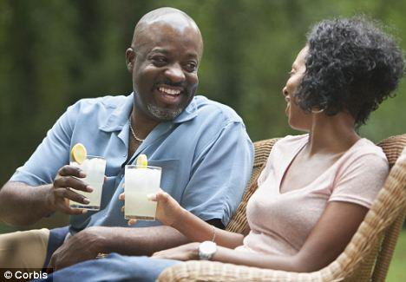

Full Menu
Lists price, description, and corresponding season

Slide 20
Fall Menu
Drink, Lists price, description
for each season

Slide 21

Seasons
Table information defining our different seasons

Slide 22

Drink Recipes
Returns ingredients and directions along with corresponding season.
A join on our two tables.

Slide 23
Github repo

